Slide 1
Chapter 19
Transaction Processing Concepts

Slide 2
Introduction to Transaction Processing
Transaction and System Concepts
Desirable Properties of Transactions
Schedules and Recoverability
Serializability of Schedules
Transaction Support in SQL
Summary
19-<number>

Slide 3
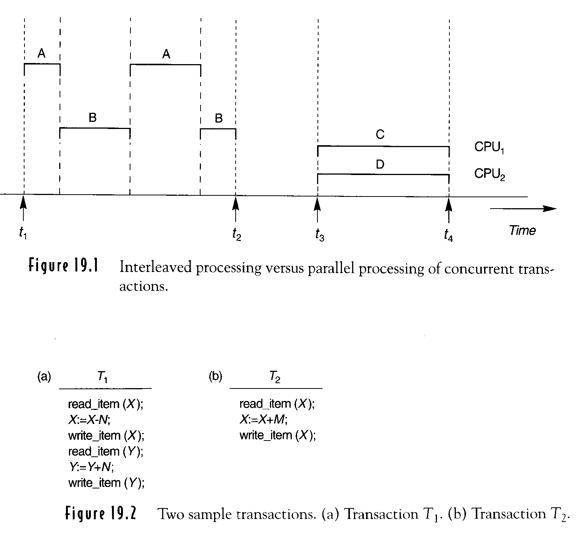
Transaction Processing Concepts
multiprogramming
O.S. ( Single CPU)
multiple CPUs
Interleaved concurrency
versus
Simultaneous
concurrency
Single-user DBMS
Multi-user DBMS
17-1
19-<number>

Slide 4
Transaction : execution of a program that accesses or
changes the contents of the database
read_item (X): read a database item into a variable
write_item(X): write the value of a variable into the database item
T1 cancels N reservations from one flight and reserves the same number of seats on another flight
T2 reserves M seats on the first flight
Read_set(T1)={X,Y}, write_set (T?)={X,Y}
problems: lost update problem
temporary update ( dirty read) problem
incorrect summary problem
……
17-2
19-<number>

Slide 5
Read-item(X)
Find the address of the disk block that contains item X.
Copy that disk block into a buffer in main memory.
Copy item X from buffer to program variable X.
17-2a
19-<number>

Slide 6
Write_item(X)
Find the address of the disk block that contains item X.
Copy the disk block into a buffer in main memory.
Copy item X from program variable X into its correct location in buffer.
Stored the updated block from the buffer back to disk
17-2a
19-<number>

Slide 7
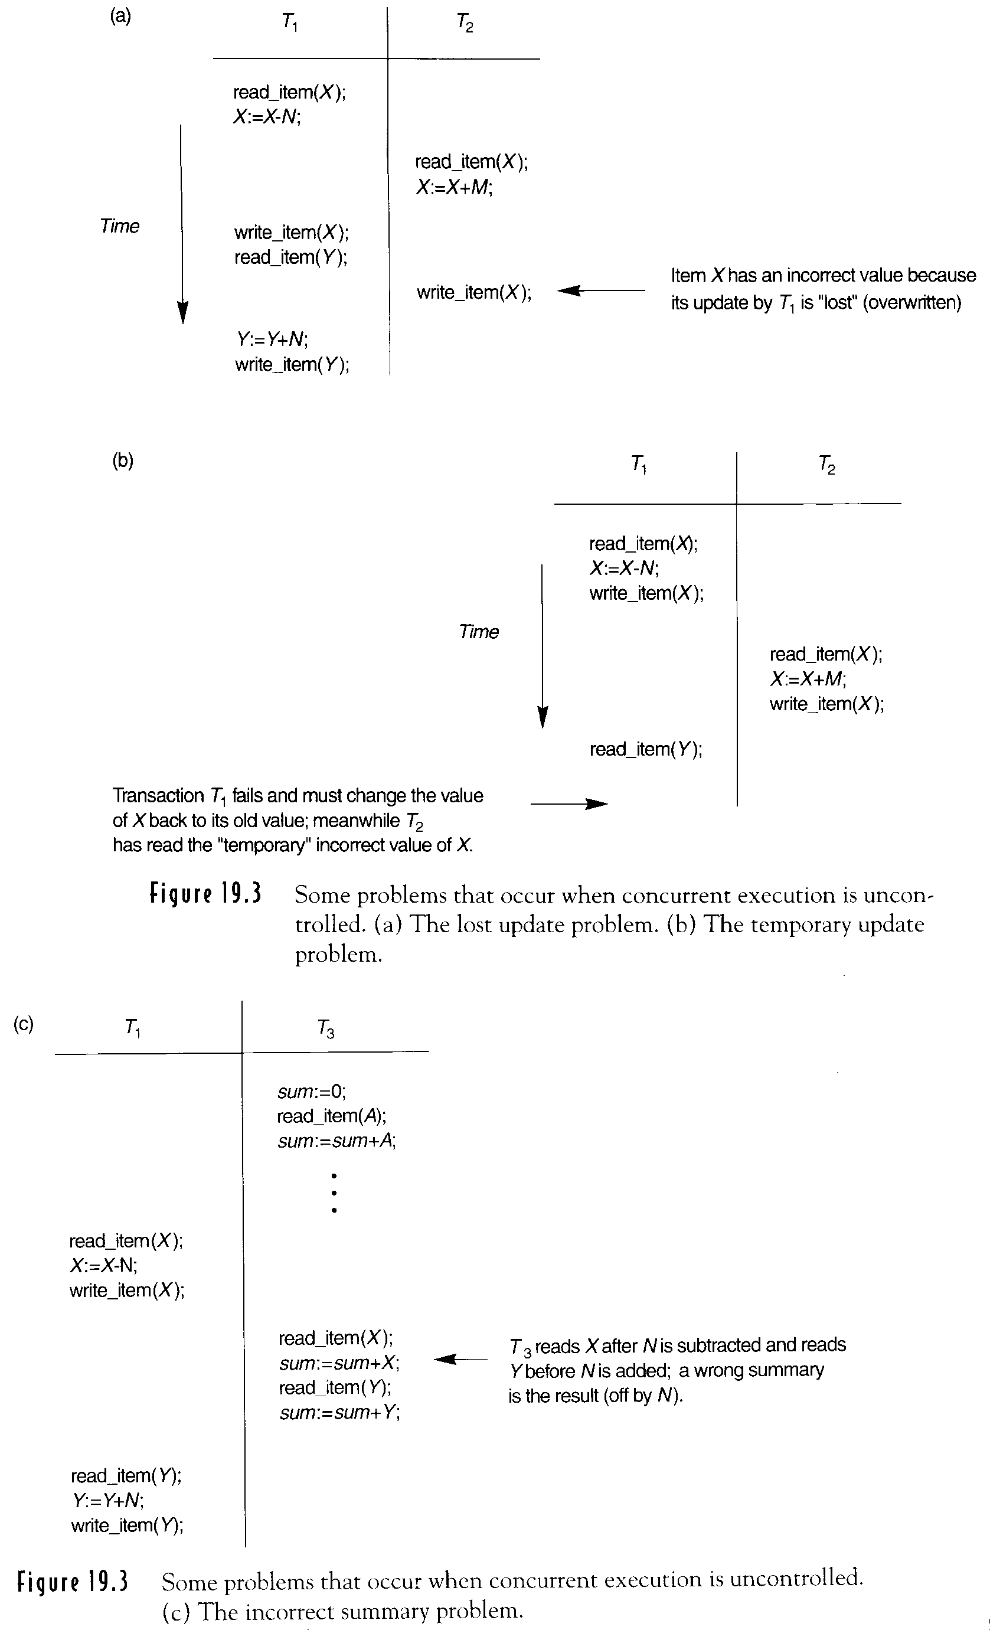
Figure 19.3(a) Lost update problem
80
↓ cancels 5 seats
75
↓ reserves 4 seats
79
5 update
lost
17-3
19-<number>

Slide 8
Figure 19.3(b)
Temporary update problem
dirty data
Computer failure (system crash), transaction or system error,
local errors or execution conditions, concurrency control
enforcement, dish failure, physical problems……
17-3
19-<number>

Slide 9
Figure 19.3(c) Incorrect Summary Problem
(total number of reservation on all fights)
Unrepeatable read
T1 T2
read_item(X)
read_item(X)
X :=X+5
write_item(X)
read_item(X)
17-4
19-<number>

Slide 10
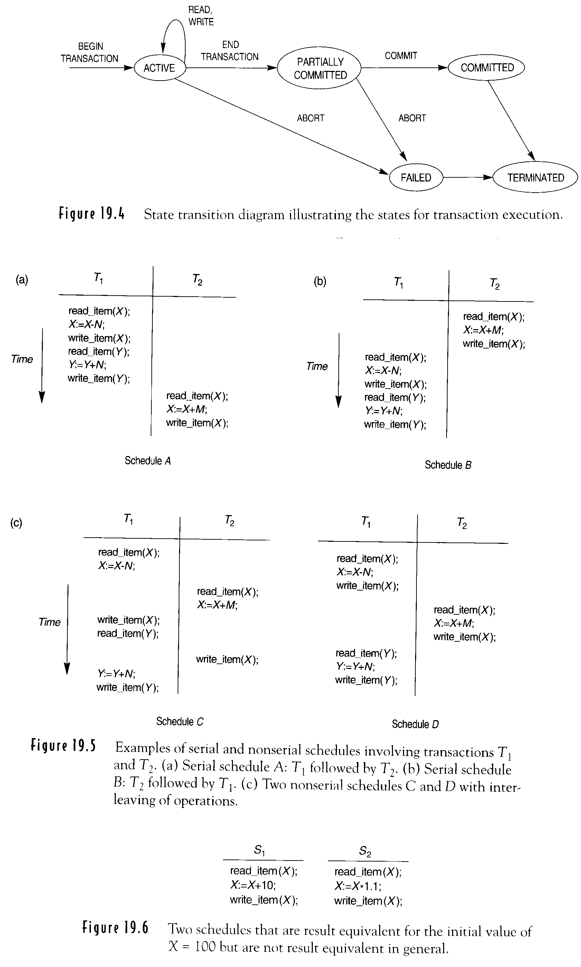
Transaction: completed in its entirety
or not done at all
Concurrency control techniques
Recovery protocol
system log
(ROLLBACK)
(ROLLBACK)
System log. (journal)
[ start_transaction, T]
[ write_item, T, X, old_value, new_value]
[ read_item, T, X]
[ commit, T]
[ about, T]
Rept on disk
17-5
19-<number>

Slide 11
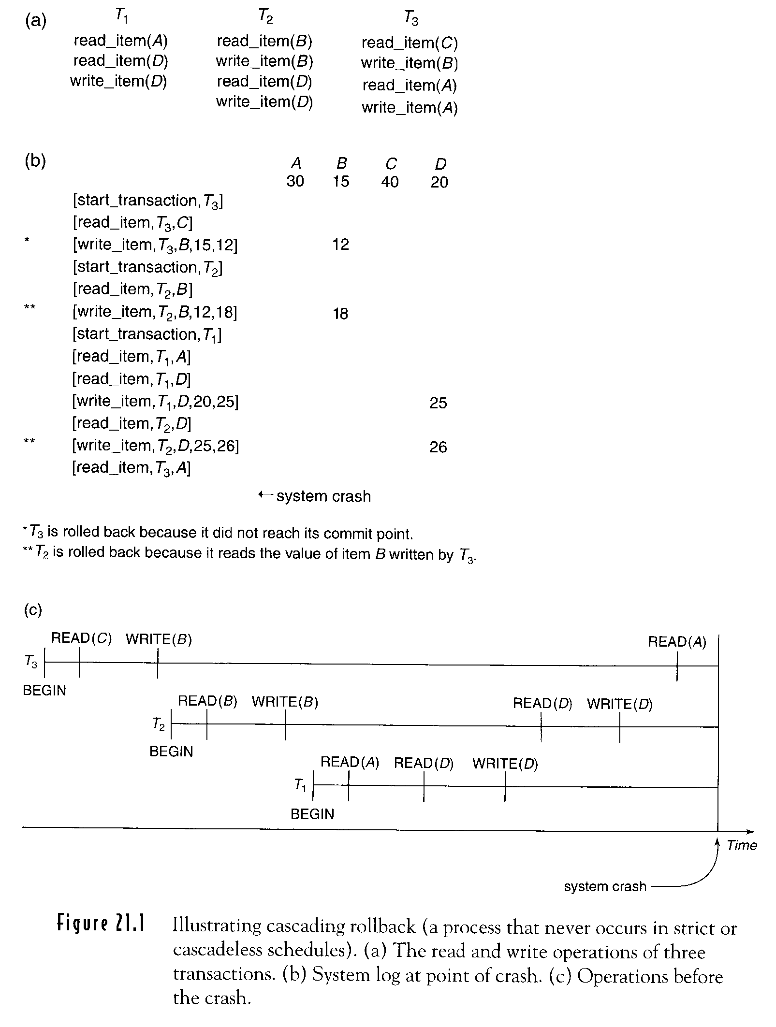
17-5a
19-<number>

Slide 12
Commit point
All operations that access database have been executed successfully
All operations have been recorded in log.
Force-writing the log file before committing a file
●
●
[start_transaction: on, T]
[commit, T]
The transactions that have not written [commit, T’]
may have to be rolled back
17-5b
19-<number>

Slide 13
Check point
The system writes out to the database the results of all WRITE operations of committed transactions.
T1
T2
redone(×)
redone(○)
T3
redone(○)
T4
ignore
Checkpoint t₁
System crash
17-5b
19-<number>

Slide 14
Intervals to take a checkpoint
every m minutes
t committed transactions
17-5c
19-<number>

Slide 15
actions
Suspend execution of transactions.
Force-write all update operations of committed transactions from MM to disk.
Write [checkpoint] to log, and
force-write log to disk.
Resume executing transactions.
17-5c
19-<number>

Slide 16
Desirable Properties of Transactions ACID properties
Atomicity: (recovery method)
completed in its entirety or not done at all.
Consistency Preservation: (programmer, DBMS)
from consistent state to another
Isolation: (concurrency control)
its updates invisible to other transactions
until commit.
Durability or permanency: (recovery method)
when changes are committed, these
changes must never be lost.
17-6
19-<number>

Slide 17
Isolation (degree isolation of a transaction)
degree 0 isolation: it does not overwrite the
dirty reads of higher–
degree transaction
degree 1 isolation: no lost updates
degree 2 isolation: no lost updates & no
dirty reads
degree 3 isolation: no lost updates
no dirty reads
no repeatable reads
17-6
19-<number>

Slide 18
Schedules and Recoverabilities
Schedule (history):
the order of execution of operations from the various transactions
S_{a}:
r₁(X);
r₂(X);
w₁(X);
r₁(X);
w₂(X);
c₂;
w₁(r);
c₁;
r : read_item
w: write_item
c : commit
a : abort
17-7
19-<number>

Slide 19
Schedules and Recoverabilities (Cont.)
S_{b}:
r₁(X); w₁(X);
r₂(X);
w₂(X);
c₂;
r₁(Y);
a₁;
17-7
19-<number>

Slide 20
conflict operations:
r₁(X) and w₂ (X)
r₂(X) and w₁ (X)
w₁(X) and w₂ (X)
nonconflict operations:
r₁(X) and r₂ (X)
w₂(X) and w₂ (Y)
r₁(X) and w₁ (X)
different transactions
Access the same item
At least one of operations: write_item(X)
17-8
19-<number>

Slide 21
Schedule S. transactions T₁, T₂,…, T_{n} complete schedule
Operations in S: operations in T₁,T₂,…,T_{n} include a commit or abort as the last operation for each transaction in the schedule
Any pair of operations from the same transaction T_{i} , their order is kept in S
Any two conflicting operations, one of the
two most occur before the order in the schedule
19-8-1
19-<number>

Slide 22
Schedule S. (Cont.) transactions T₁, T₂,…, T_{n} complete schedule
T₁: r₁(X), w₁(X), r₁(Y), w₁(Y)
T₂: r₂(X), w₂(X)
S_{a}: r₁(X), r₂(X), w₁(X), r₁(Y), w₂(X), c₂ ,w₁(Y),c₁
S_{b}: r₁(X), w₁(X), r₂(X), w₂(X), r₁(Y), a₁
19-8-1
19-<number>

Slide 23
Committed projection c(S) of schedule S
Include only the operation is S that belong to committed transactions
19-8-2
19-<number>

Slide 24
Characterizing Schedules Based on Recoverability
which recovery is simple
which recovery is possible
Recoverable Schedule:
once a transaction T is committed, it should never be
necessary to roll back T.
No transaction T in S commits
until all transactions T’ that
have written an item that T
reads have committed.
T 可以 read
只是 commit
可能會延後

Slide 25
Recovery algorithm : complex
S_{a}: r₁(X); r₂(X); w₁(X); r₁(Y); w₂(X);c₂; w₁(Y);c₁
: recoverable
(lost update)
S_{c}: r₁(X); w₁(X); r₂(X); r₁(Y); w₂(X); c₂ ; a₁
: not recoverable
C₂ must postpone
until T₁ commits
If T1 aborts after c2, then the value of X
but T2 read is no longer valid
T₂ should be
rolled back !!
S_{d}: r₁(X); w₁(X); r₂(X); r₁(Y); w₂(X); w₁(Y);c₁;c₂
: recoverable
17-9
19-<number>

Slide 26
Cascading rollback (cascading abort)
time-consuming
S_{e}: r₁(X); w₁(X); r₂(X); r₁(Y); w₂(X); w₁(Y); a₁; a₂
T₁ is aborted→T₂ is rolled back
17-10
19-<number>

Slide 27
Avoid cascading rollback schedule
Every transaction only reads items that were written by committed transactions.
S_{e’}: r₁(X); w₁(X);
r₂(X) is delayed
r₁(Y);
w₁(Y); c₁;
r₂(X) w₂(X);
X=9 w₁(X, 5); w₂(X, 8); a₁;
連read 都不行,但可以write
17-10
19-<number>

Slide 28
Strict Schedule
(recoverable & avoid cascading rollback)
Transactions can neither read nor write an item X until the last transactions that wrote X has committed (or aborted)
S_{f}: X=9 w₁(X, 5); w₂(X, 8); a₁;
not strict schedule
avoid cascading rollback schedule
read 與write都不可
Simplify
recovery process
Restore BFIM of
17-10
19-<number>

Slide 29
(1) Recoverability
(2) Avoidance of cascading rollback
(3) Strictness
(2) ⇒ (1)
(3) ⇒ (2), (1)
(1) ⇒ (2) (?)
(2) ⇒ (3) (?)
(1) ⇒ (3) (?)
19-10-1
19-<number>

Slide 30
Figure 19.5 (a) (b)
serial schedule
T₁ followed by T₂
T₂ followed by T₁

Slide 31
Figure 19.5 (c) Two schedules with interleaving of operation
read old value
lost update
nonserial schedule
Every serial schedule is correct
A schedule is serializable if it is equivalent to some serial schedule
X=90, Y=90, N=3, M=2
T1: X=89 Y=93 C: X=92, Y=93 nonserializable
T2: D: X=89, Y=93 serializable

Slide 32
Two schedules are said to be conflict equivalent if the order of any two conflicting operation is the same in both schedules.
S_{a}: r₁(X), W₂(X) w₁(X), w₂(X)
S_{b}: w₂(X), r₁(X) w₂(X), w₁(X)
17-12
19-<number>

Slide 33
A schedule S is conflict serializable if its conflict equivalent to some serial schedule S’
A
D
r₁(X), w₁(X), r₁(Y), w₁(Y), r₂(X), w₂(X)
r₁(X), w₁(X), r₂(X), w₂(X), r₁(Y), w₁(Y)

Slide 34
(A)
(C)
A r₁(X), w₁(X), r₁(Y), w₁(Y), r₂(X), w₂(X)
C r₁(X), r₂(X), w₁(X), r₁(Y), w₂(X), w₁(Y)
B r₂(X), w₂(X), r₁(X), w₁(X), r₁(Y), w₁(Y)
C r₁(X), r₂(X), w₁(X), r₁(Y), w₂(X), w₁(Y)
C is not equivalent to A and B

Slide 35
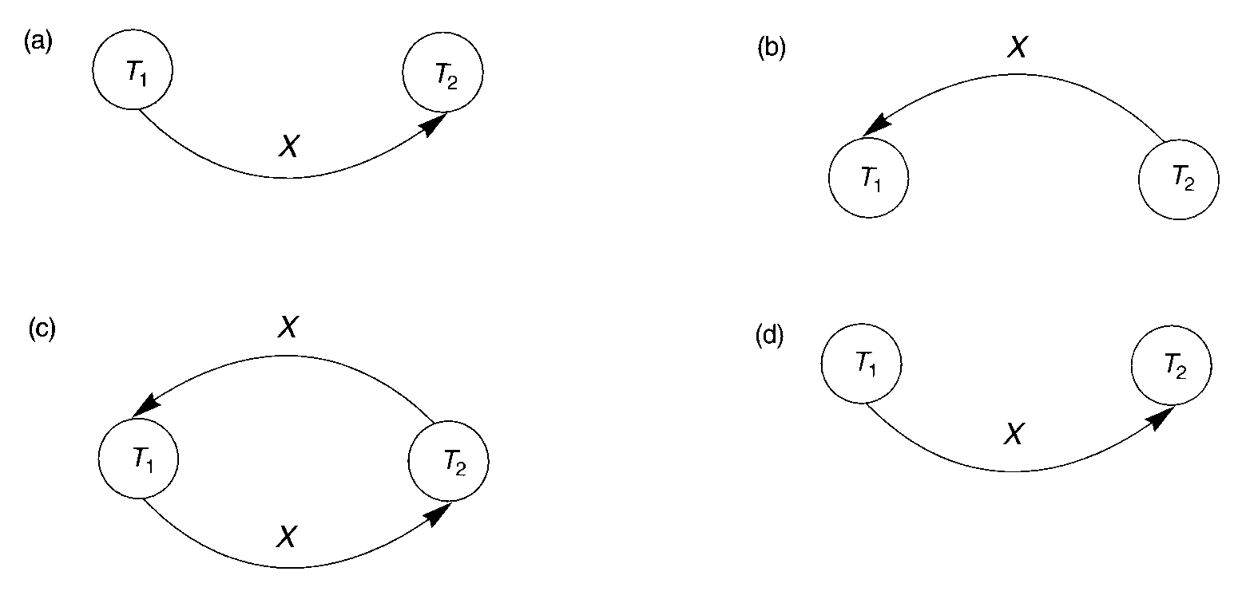
Test for Conflict Seralizability of a Schedule
Figure 19.7 Precedence Graph (Serialization Graph)
r₁(X), w₁(X), r₁(Y), w₁(Y), r₂(X), w₂(X)
r₂(X), w₂(X), r₁(X), w₁(X), r₁(Y), w₁(Y)
T₁ must come
before T₂ in a
serial Schedule
r₁(X), r₂(X), w₁(X), r₁(Y), w₂(X), w₁(Y)
r₁(X), w₁(X), r₂(X), w₂(Y), r₁(Y), w₁(Y)

Slide 36
(Cont.)
Test for Conflict Seralizability of a Schedule
For each T_{i} in S, create a T_{i} node in graph
For each case in S where T_{j} executes a r(X) after a w(X) command executed by T_{i} create T_{i} → T_{j}
For each case in S where T_{j} executes a w(X) after T_{i} executes r(X), create T_{i} → T_{j}
For each case in S where T_{j} execute a w(X) after T_{i} execute w(X) create Ti → T_{j}
S is serializable if graph has no cycles
17-14
19-<number>

Slide 37
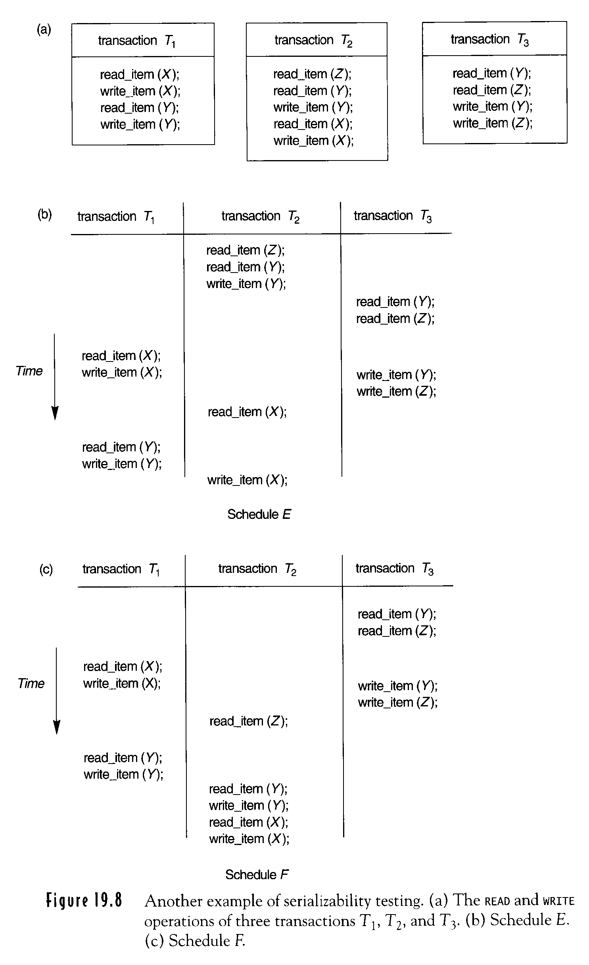
READ and WRITE of three transactions
Schedule E of transactions T₁, T₂ and T₃
Figure 19.8(a)(b)
17-15
19-<number>

Slide 38
Figure 19.8(c) Schedule F of transactions T₁, T₂ and T₃
17-15
19-<number>

Slide 39
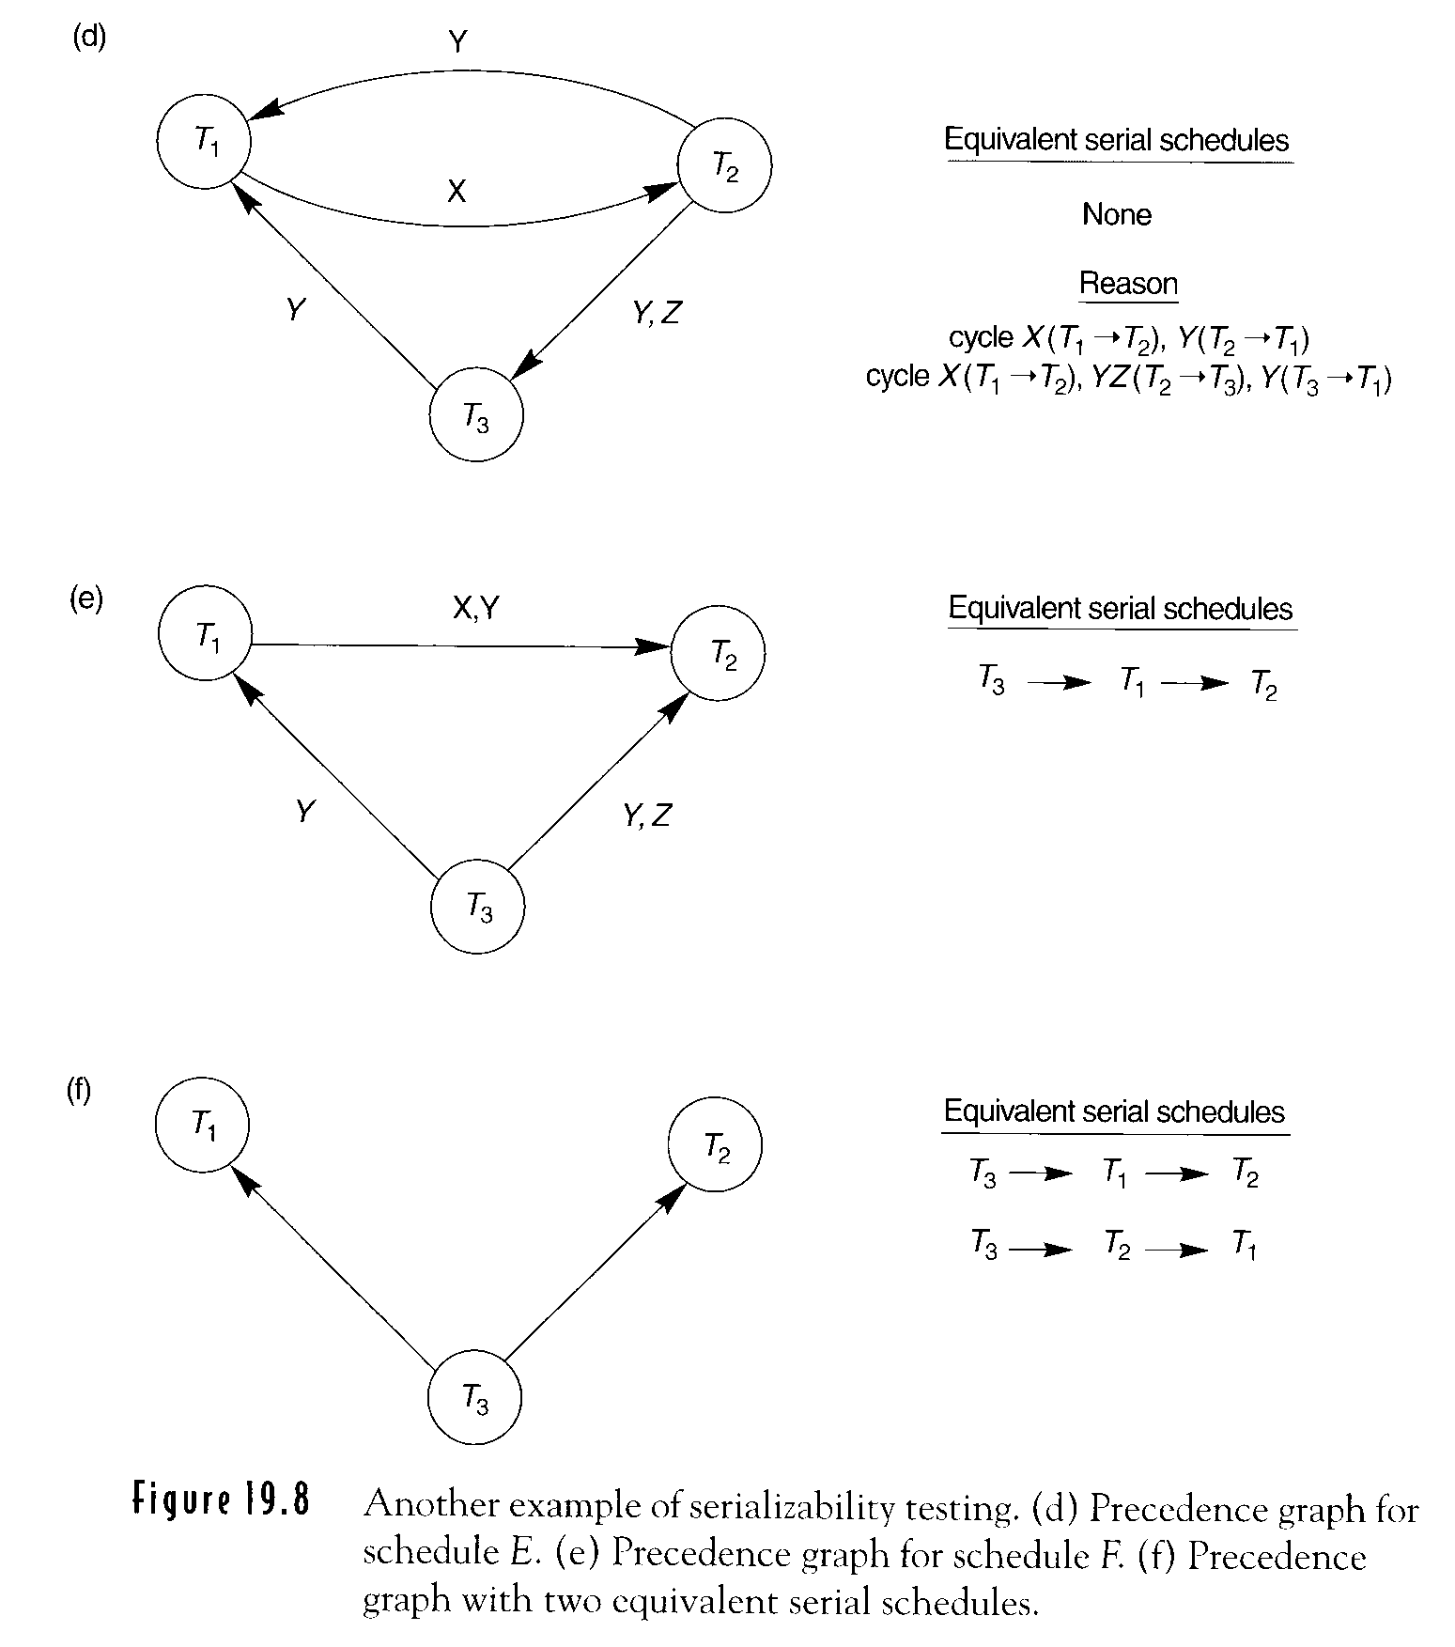
①
r₂(Z), r₂(Y), w₂(Y), r₃(Y), r₃(Z), r₁(X),
w₁(X), w₃(Y), w₃(Z), r₂(X), r₁(Y), w₁(Y), w₂(X)
④
③
②
⑤
Figure 19.8(d)
②
① ④
③
17-16
19-<number>

Slide 40
④
r₃(Y), r₃(Z), r₁(x), w₁(X), w₃(Y), w₃(Z), r₂(Z)
r₁(Y), w₁(Y), r₂(Y), w₂(Y), r₂(X), w₂(X)
①
③
②
③
②
①
④
Figure 19.8(e)
17-16
19-<number>

Slide 41
17-16
19-<number>

Slide 42
How to evaluate if a schedule is correct?
A schedule is serializable
How to test for the serializability of a schedule?
Use protocols or set of rules
two phase locking, time stamping ordering
How to determine when a schedule begins and when it ends? Use definition of committed projection
c(S): include only the operations in S that belong to committed transaction
A schedule S to be seriable if its committed projection is
equivalent to some serial schedule
17-17
19-<number>

Slide 43
Transaction Support in SQL
SQL-transaction:
a logical unit of work and atomic
Single SQL statement is atomic
No explicit BEG2N_TRANSACTION statement
Explicit and statement
COMMIT or ROLLBACK
Characteristics (SET TRANSACTION)
access mode
diagnostic area size
isolation level
19-18
19-<number>

Slide 44
Characteristics (SET TRANSACTION)
Access mode
READ WRITE (default)
update, insert, delete, create
READ ONLY
retrieval
(let transaction execute in parallel with others)
19-19-1
19-19
19-<number>

Slide 45
Characteristics (SET TRANSACTION)
Diagnostic area size
DIAGNOSTIC SIZE n
  The number of conditions that can be held simultaneously in diagnostic area
  Feed back information
19-19
19-<number>

Slide 46
Characteristics (SET TRANSACTION)
Isolation level
ISOLATION LEVEL <isolation>
READ UNCOMMITTED
READ COMMITTED
REPEATABLE READ SERIALIZABLE (default)
19-19
19-<number>

Slide 47
Choose a Seat
EXEC SQL BEGIN DELLARE SECTION;
int flight;
char date[10];
char Seat[3];
int occ;
EXEC SQL END DELLARE SECTION;
void choose Seat() {
:
:
EXEC SQL SET TRANSACTION READ ONLY;
EXEC SQL SELECT occupied INTO : occ
FROM Flights
WHERE fltNam=: flight AND fltDate=: date AND fltSeat=:Seat;
if(!occ){
EXEC SQL SET TRANSACTION READ WRITE;
EXEC SQL UPDATE Flights
SET occupied=‘B1’
WHERE fltNum=:flight AND fltDate=: date AND fltSeat=: Seat;
} } … …
19-19-1
19-<number>

Slide 48
SERIALIZABLE
dirty read, unrepeatable read, phantoms are not
allowed.
Dirty Read
… w₂(X), r₁(X), …, a₂
T1 read a value that does not exist and is incorrect
in some cases, dirty reads are allowed (19-21)
Nonrepeatable read
…, r₁(X), w₂(X), r₁(X), …
T1 Sees a different value at two different times
in some cases, non repeatable reads are allowed.
(19-22)
19-20
19-<number>

Slide 49
Phantoms:
…, r₁(S), w₂(t), r₁(S), …
a set of tuples
phantom
in some cases, phantoms are allowed.
19-20
19-<number>

Slide 50
SET ISOLATION LEVEL READ UNCOMMITTED
最鬆
When dirty reads are allowed, the default for access mode is READ ONLY.
Example: Seat-choosing
We find an available seat and reserve it by setting occupied to 1 for that seat. If there is none, abort.
Speed up the average processing time for booking request
19-21
19-<number>

Slide 51
(Cont.)
SET ISOLATION LEVEL READ UNCOMMITTED
We ask the customer for approval of the seat. If so, we commit. If not, we release the seat by setting occupied to 0 and repeat step 1 to get another seat.
T_{A}, T_{B}: two transactions A, B
choose another seat
no seats exist?
S_{1A}, S_{1B}, S_{2A},
Seat S is
marked
unavailable
Customer
rejects S
S available
again
19-21
19-<number>

Slide 52
SET TRANSACTION ISOLATION LEVEL
READ COMMITTED
嚴一點
Forbid the reading of dirty (uncommitted) data
Allow one transaction to issue the same query several times and get different answers, as long as the answers reflect data that has been written by transactions that already committed.
S_{1A} Seat S is marked unavailable
S_{1B} B 看不到 uncommitted transactions 所reserve的 seats
S_{1B} b sees a different set of available sets
19-22
19-<number>

Slide 53
SET TRANSACTION ISOLATION LEVEL REPEATABLE READS (misnomer)
If a tuple is retrieved the first time, then we can be sure that tuple will be retrieved again if the query is repeated.
A second or subsequent execution of the same query will retrieve phantom tuples. (tuples that are inserted when our transaction is executing)
Switch the flight to a larger plane
更嚴
S_{1A} Seat S is marked unavailable
S_{1B}
S_{2A}
S_{1A} S and other new seats are available
S_{1B} S is still unavailable
19-23
19-<number>

Slide 54
Dirty
Read
Nonrepeatable
Read
phantom
READ
UNCOMMITTED yes yes yes
READ
COMMITTED no yes yes
REPEATABLE
READS no no yes
SERIZABLE no no no
最嚴

Slide 55
EXEC SQL WHENEVER SQLERROR GoTo UNDO;
EXEC SQL SET TRANSACTION
READ WRITE
DIAGNOSTICS SIZE 5
ISOLATION LEVEL SERIALIZABLE;
EXEC SQL INSERT INT
EMPLOYEE(FNAME, LNAME, SSN, DNO, SALARY)
VALUES (‘Robert’, ‘smith’, ’991004321’, 2, 35000)
EXEC SQL UPDATE EMPLOYEE
SET SALARY=SALARY * 1.1
WHERE DON=2;
EXEC SQL COMMITT;
GoTo THE END;
UNDO: EXEC SQL ROLLBACK;
THE END: …;
Before this, changes are tentative (may
or may not be visible to other
transaction)
any changes are undone
updated salaries newly inserted row
19-25
19-<number>

Slide 56
Ch18 Concurrency Control Techniques
Protocols
locking
timestaming
multiversion
optimistic
Granularity
Phantom
18-1
19-<number>

Slide 57
Concurrency control mechanism
– avoid the problems similar to “ lost update problem ”
A concurrency control mechanism has three places that it could intervene to prevent this inconsistency.
Time
t₁
t₂
t₃
t₄
Transaction A
Read(R) r(R)
•
Write(R) w(R)
•
Transaction B
•
Read(R) r(R)
•
Write(R) w(R)
At time t₂, it could deny B access R, because A
has already read it (and is likely to change it)
11-3
19-<number>

Slide 58
At time t₃, it could refuse to let A write a new
value for R, because B is looking at the old value.
At time t₄, it could refuse to let B write a new
value for R, because its update is based on the
incorrect value of R.
and (b) – locking
and (c) – timestamping
tradeoff : system overhead vs. parallelism
11-3
19-<number>

Slide 59
Exclusive Locks
Locking – a technique for regulating
concurrent access to shared objects.
Transaction
request
Lock Manager
Lock
Record
11-4
19-<number>

Slide 60
Exclusive Locks (Cont.)
Exclusive Locks Shared Locks
Update Locks
Lock type
Locking Techniques
Binary Locks
Binary Locks
Shared Locks
Exclusive Locks
Locked
Unlocked
18-2
19-<number>

Slide 61
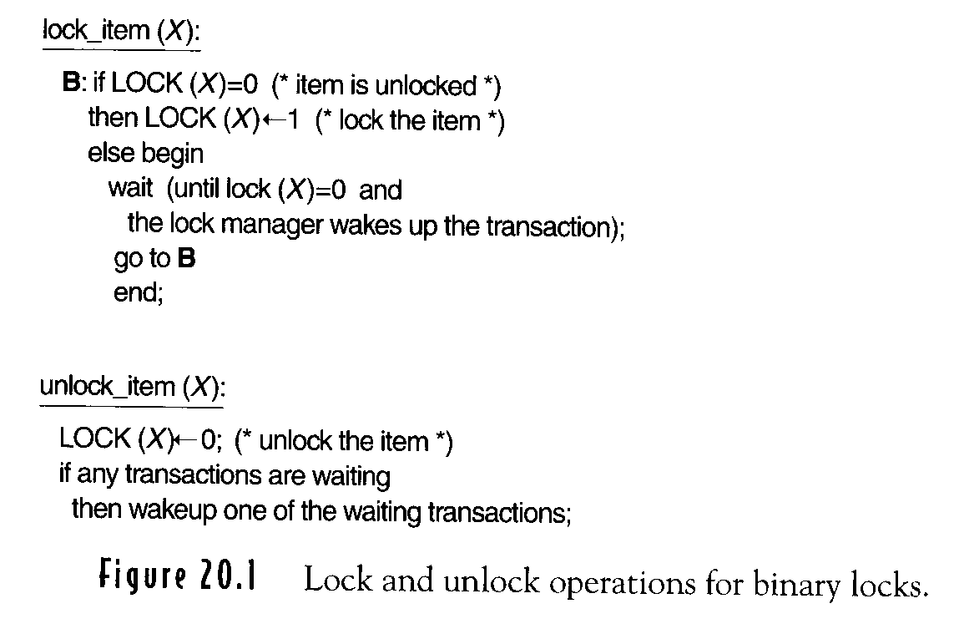
(a)點 Figure 20.1 Lock and unlock operations for binary locks
(indivisible unit)
(indivisible unit)
A transaction must issue lock_item(X) before
read_item(X) or write_item(X)
A transaction must issue unlock_item(X) after read_item(X) and write_item(X)
A transaction will not issue lock_item(X) if it already holds lock on X
A transaction will not issue unlock_item(X) unless it already holds lock on X
<data item name, locks> + queues for waiting transactions
18-2
19-<number>

Slide 62
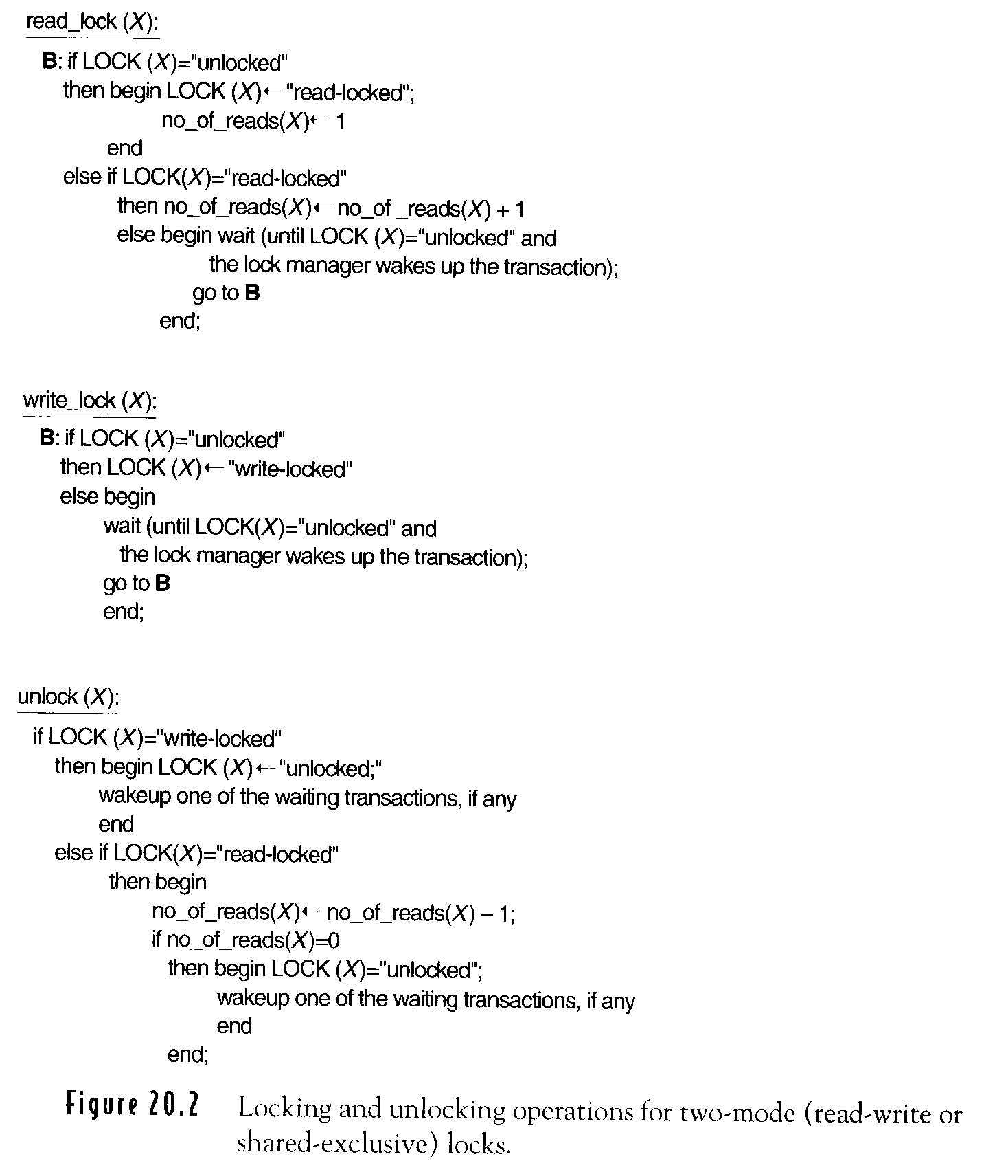
(b)點 Figure 20.2 Shared and Exclusive Locks
read-locked (share-locked)
write-locked (exclusive-locked)
unlocked
(indivisible unit)
18-3
19-<number>

Slide 63
Figure 20.2 Shared and Exclusive Locks (Cont.)
(indivisible unit)
18-3
19-<number>

Slide 64
Figure 20.2 Shared and Exclusive Locks (Cont.)
(indivisible unit)
<data_item name, Lock, no_of_reads>
Read_locked, write_locked, unlocked
18-3
19-<number>

Slide 65
Multiple-mode locking scheme
A transaction must issue read_lock(X) or write_lock(X) before read_item(X)
讀了後可能會去更改
A transaction must issue write_lock(X) before write_item(X)
A transaction must issue unlock(X) after read_item(X) and write_item(X)
18-4
19-<number>

Slide 66
Multiple-mode locking scheme (Cont.)
A transaction will not issue read_lock(X) if it already holds a read (shared) lock or write (exclusive) lock on X
upgrade (relax)
A transaction will not issue write_lock(X) if it already holds a read (shared) lock
or write (exclusive) lock on X.
downgrade (relax)
A transaction will not issue an unlock(X) unless it already holds a read lock or write lock on it.
18-4
19-<number>

Slide 67
Two-phase locking protocol
all locking operations precede the first
unlock operation in the transaction.
Expanding (growing) phase
new locks on items can be acquired but
none can be released
Shrinking phase
existing locks can be released but no new
locks can be acquired
Upgrading of locks
unchanged
Downgrading of locks
done in the shrinking phase
18-5
19-<number>

Slide 68
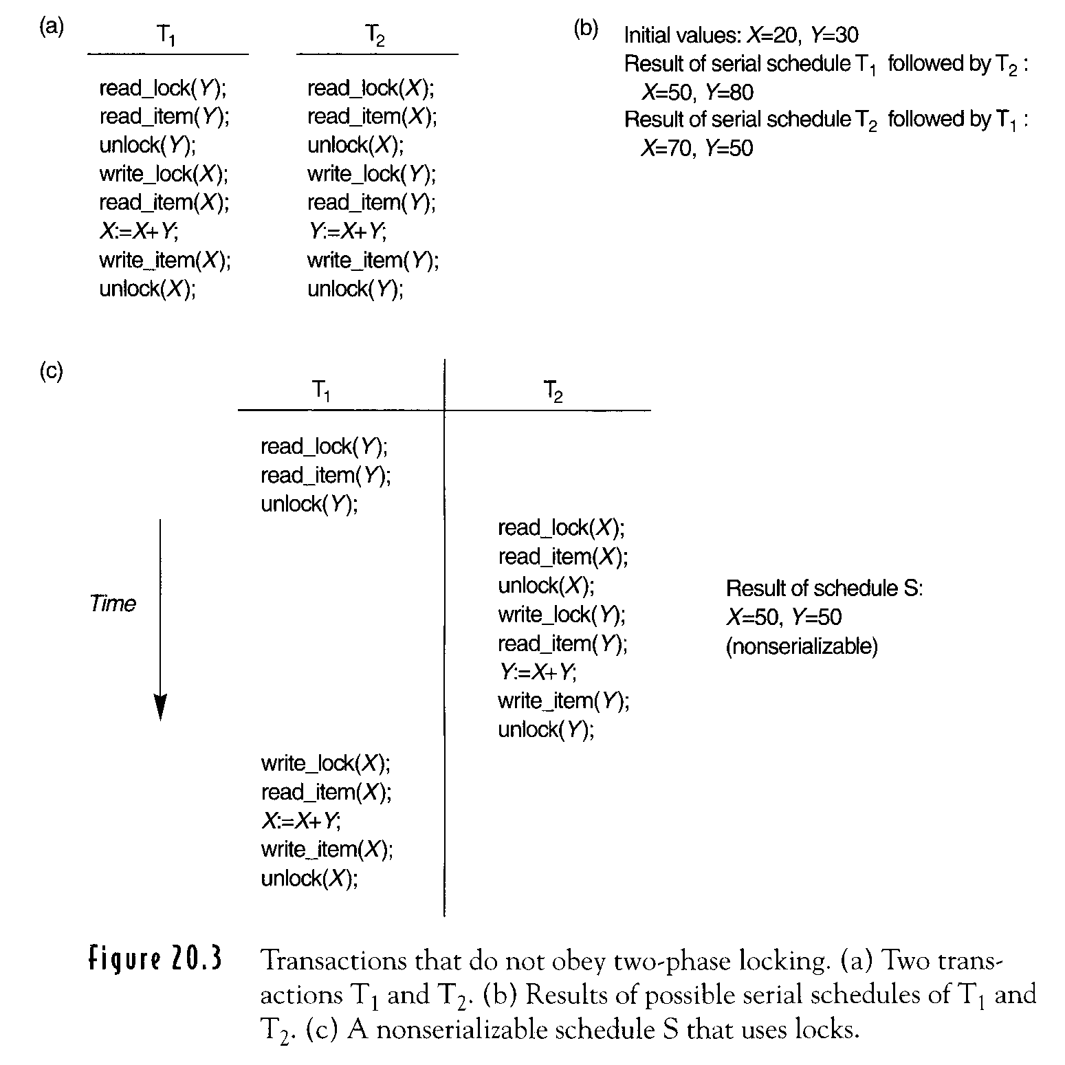
T₁ & T₂ don’t follow 2 phase protocol
Nonserializable Schedule
old value
Figure 20.3
18-6
19-<number>

Slide 69
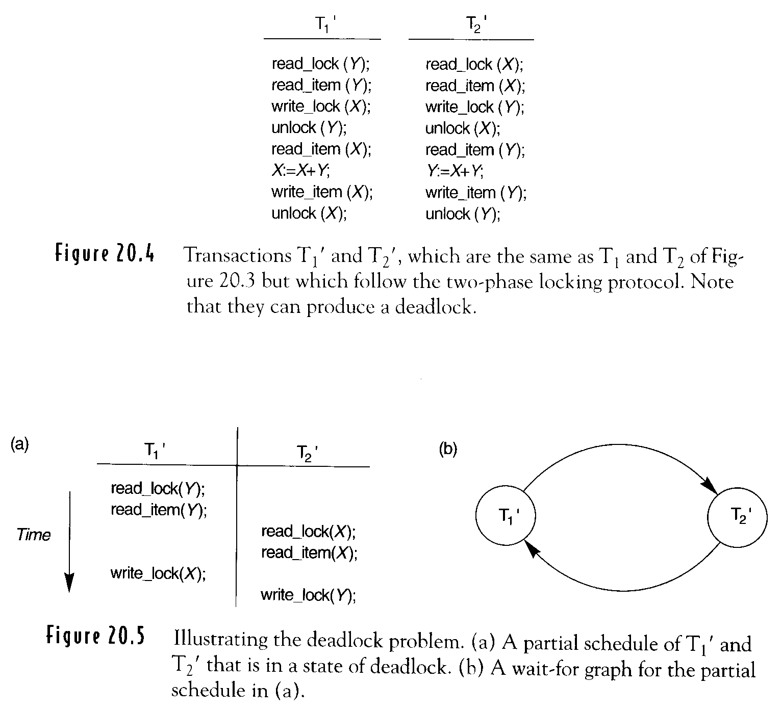
Expanding phase
T₁’ & T₂’ follow 2 phase locking protocol
•
•
Shrinking phrase
•
•
•
•
•
•
18-7
19-<number>

Slide 70
Basic 2-phase locking protocol
Advantage:
guaranteeing serializability without having to check the
schedules themselves
Disadvantages :
limiting the amount of concurrency
deadlock
livelock
Predeclare
read set
write set
(dead lock free)
Conservative 2-phase locking:
lock before start lock all the item it accesses before
transaction begin
Strict 2-phase locking:
unlock after terminate transaction does not release
any locks until commit or abort
(not dead lock free)
18-7
19-<number>

Slide 71
Conservative 2PL (static 2PL)
Lock all the items it accesses before transaction begins
(lock before start)
predeclare
Transaction start
：
：
：
Shrinking phase
read set
write set
(dead lock free protocol)
18-7.1
19-<number>

Slide 72
Strict 2PL
Transaction does not release any write locks until commit or abort (exclusive)
(unlock after terminate)
(not dead lock free)
Guarantee strict schedule
transactions can neither read nor write an item X
until the last transaction that wrote X has
committed (or aborted)
：
：
：
Expanding phase
Transaction terminate
18-7.1
19-<number>

Slide 73
Rigorous 2PL
A transaction T does not release any of its lock (exclusive or shared) until it commits or aborts concurrency control subsystem
(strict 2PL protocol)
18-7.2
19-<number>

Slide 74
Transaction T system resource X
1) read_item(X) read_lock(X) (a) write_locked by T₁
T: waiting queue
(b) available
read_lock(X)
2) write_item(X) write_lock(X) (a) write_locked or
read_locked by T’
T:waiting queue
(b) read_locked by T only
write_lock(X)
(c) available
write_lock(X)

Slide 75
(Cont.)
Transaction T system resource X
3) Unlock(X) grant write_lock (a) waiting queue
Every schedule that is permitted is serializable.
Not all possible serializable schedule are permitted.
dead lock
starvation
problems
18-7.3
19-<number>

Slide 76
18-8
19-<number>

Slide 77
Dealing with Deadlock and Livelock
Deadlock prevention protocol
  Conservative two-phase locking
  Every transaction locks all the items it needs in
  advance. ⇒ limit concurrency
  Wait-die and wound-wait
  T_{i} tries to lock an item hold by T_{j}
    Wait-die:
    if TS(T_{i}) < TS(T_{j})
    then T_{i} is allowed to wait.
    Otherwise abort T_{i} ( T_{i} die) & eate
    restart it with the same timestamp
    older transaction waits on younger transaction
T₁
T₂
T_{n}
T₁
、、、
t₁ < t₂ <……< t_{n} < t₁
18-8a
19-<number>

Slide 78
(Cont.)
Dealing with Deadlock and Livelock
    wound-wait:
    if TS(T_{i}) < TS(T_{j})
    then abort T_{j} is ( T_{i} wounds T_{j}) &
    restart it (ate with the same timespamp
    otherwise Ti is allowed to wait.
    younger transaction waits on old transaction
T₁
T₂
T_{n}
T₁
、、、
t₁ > t₂ >……> t_{n} > t₁
18-8a
19-<number>

Slide 79
No Waiting
If a transaction is unable to obtain a lock, it is immediately aborted and then restarted after a certain time delay.
18-9
19-<number>

Slide 80
Cautious Waiting
T_{i} tries to lock an item X that is locked by T_{j}
if T_{j} is not blocked
then T_{i} is blocked and allowed to wait
otherwise abort T_{i}
blocking time form a total ordering
T₁
T₂
、、、
T_{n}
T₁
b(T₁) <b(T₂)<…<b(T_{n})<b(T₁) ?
b(T): time at which T was blocked
18-9
19-<number>

Slide 81
Deadlock Detection Mechanism
Periodically check if the system is deadlock
setup wait-for graph
check for deadlock (cycle)
select the victim
Timeout
if a transaction waits for a period
longer than a system-defined timeout
period, then the transaction is aborted
18-9.1
19-<number>

Slide 82
Line Lock
First come first serve
18-9.1
19-<number>

Slide 83
Timestamp Techniques = do not use locks
※ Each transaction is assigned a unique identifier (the timestamp)
transaction start time
※ Timestamp is thought of as transaction’s start-time
order transactions based on timestamps
※ Where does a conflict occur?
Time
t₁
t₂
Time
t₁
t₂
Time
t₁
t₂
older
younger
Transaction A
FIND R r(R)
Transaction A
UPD R W(R)
Transaction A
UPD R
Transaction B
UPD R W(R)
Transaction B
FIND R r(R)
Transaction B
UPD R W(R)
t_{A} < t_{B}
t_{A} < t_{B}
t_{A} < t_{B}
11-47
19-<number>

Slide 84
Time
t₁
t₂
t₃
t₄
Transaction A
FIND R r(R)

UPD R w(R)

Transaction B

FIND R r(R)

UPD R w(R)
(b)
(c)
Assumption:A is younger than B.
timestamp (A) > timestamp (B)
B will restart at t₄ case(c)
Assumption:A is older than B
timestamp(A) < timestamp(B)
A will restart at t₃ case(b)
11-48
19-<number>

Slide 85
Concurrency Control
Based on Timestamp Ordering
Timestamps
created by DBMS to identify a transaction
Timestamp ordering
The equivalent serial schedule has the transaction in the order of their timestamping value
18-10
19-<number>

Slide 86
Concurrency Control
Based on Timestamp Ordering (Cont.)
Each database item X with two timestamp (TS) values:
Read_TS(X): read timestamp
largest (youngest) timestamp among all the timestamps of transactions that have successfully read item X.
Write_TS(X): write timestamp
largest (youngest) timestamp of all the transactions that have successfully written item X
18-10
19-<number>

Slide 87
Basic Timestamp Ordering
Transaction T issues a write_item(X)
  If read_TS(X)>TS(T) or write_TS(X)>TS(T)
  then abort and roll back T and reject the operation.
  abort: resubmit to the system as a new
  transaction with a new timestamp
  roll back: cascading roll back
  Otherwise, execute write_item(X) and set write_TS(X) to TS(T)
(2)
(3)
18-11
19-<number>

Slide 88
Basic Timestamp Ordering (Cont.)
Transaction T issues a read_item(X)
  If write_TS(X) > TS(T), then abort and roll back T and reject the operation
  If write_TS(X) <= TS(T), then execute read_item(X) and
  set read_TS(X) =max( TS(T), read_TS(X) )
Detect two conflicting operations in incorrect order.
Deadlock does not occur.
Cyclic restart may occur.
Reject the latter
Conflict serializable
18-11
19-<number>

Slide 89
Strict Timestamp Ordering
Ensure both conflict serializability
and recoverable schedule
A transaction T that issues a read_item(X) or write_item(X) such that
TS(T) > write_TS(X) has its read or write operation delayed until the transaction T’ that wrote the value of X has committed or aborted
18-11a
19-<number>

Slide 90
Locking Granularity
What is the unit of locking?
an entire database,
the set of records of a given type,
individual record,
specific field within a record.
tradeoff: (depend on types of transactions involved)
the finer the greater the concurrency,
the coarse the lower the overhead.
overhead
concurrency
Small # of records: record
many records: file
11-38
19-<number>

Slide 91
Implementation Principle No. 1:
The system can safely lock more than the
minimum requested.
Implementation Principle No. 2:
The system can safely retain locks longer
than requested.
11-38
19-<number>

Slide 92
Using Locks for Concurrency
Control in Indexes (disk pages)
Search (read)
a path is traversed from the root to a leaf
  Once a read lock on the child is obtained, the lock on the parent can be released.
Insertion (write)
insertion to a leaf node, the node must be locked in exclusive mode.
  Not full
  Full: insertion upward
18-12
19-<number>

Slide 93
Conservative Approach for Insertions
Lock the root node in exclusive mode and then access the appropriate child node of the root.
If the child node is not full,
then the lock on the root node can be released
18-13
19-<number>

Slide 94
Optimistic Approach for Insertions
Request and hold shared locks on the nodes leading to the leaf node.
Exclusive lock on the leaf
Leaf is split.
Locks on the higher level nodes are upgraded to exclusive mode.
18-13
19-<number>

Slide 95
B-link tree:
a variant of the B⁺-tree
Sibling nodes on the same level are linked
together at every level
Shared lock is used when requesting a page
the lock is released before releasing the child
node.
For insertion, the shared lock on a node would be upgraded to exclusive mode.
Search operations are executed concurrency with the update split
18-14
19-<number>

Slide 96
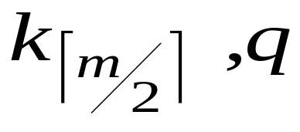
P node: m, A₀, (K₁, A₁),…,(K_{m}, A_{m})
K_{i}< K_{i+1}, 1≦ i≦ m
split
Insert ( ) to parent of P.
When the insert is done, the search process resumes.
The key it is locking for is not present
the split has moved that key into a new leaf node
right sibling of the original node i.e.q
18-15
19-<number>

Slide 97
Phantom Problem
Example:
F, G, H: fields in the database
A, B: transactions
if F exists
then G:=1;
else G:=0:
if F does not exist
then
do;
create F;
G:=1;
end;
Initially:
F does not exist
A-then-B:
F exists, G=1
B-then-A:
F exists, G=1
11-31
19-<number>

Slide 98
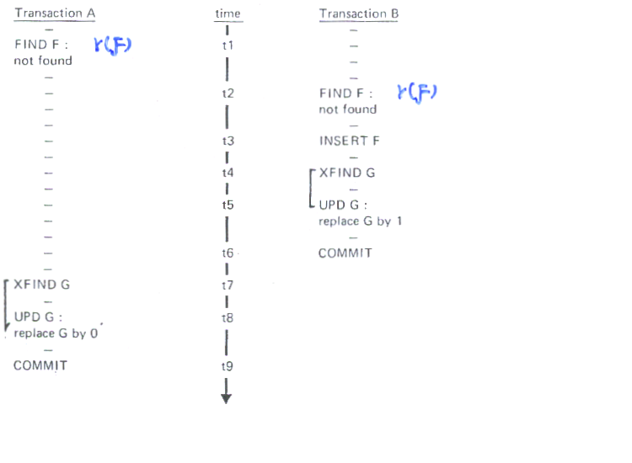
Interleaved execution of A and B:
F exists, G=0
→ not serializable
→ two phase locking is not valid?
11-32
19-<number>

Slide 99
Nonexistence of data– phantom
Update the nonexistence– INSERT operation
Transaction A
－
FIND F: r(F)
Not found
－
－
－
－
－
－
－
－
－
－
XFIND G
－
UPD G:
Replace G by 0
－
COMMIT
Time
t1
t2
t7
t8
t9
Transaction B
－
－
－
－
－
－
SFIND F
Wait
Wait
Wait
Wait
Wait
Wait
Wait
Wait
Wait
Wait
Wait
resume
Implementation: index locking
11-33
19-<number>

Slide 100
Phantom problem:
A new record that is being inserted by some transaction T satisfies a condition that a set of records accessed by another transaction T’ must satisfy.
18-16
19-<number>

Slide 101
Phantom problem: (Cont.)
Example:
T : insert a new EMPLOYEE record whose DNo=5 T’: access all EMPLOYEE records whose DNo=5
Index locking
T’: request a read lock on index entry for DNo=5
T : request a write lock on the same entry before
placing locks on actual records
① T T’
② T’ T
18-16
19-<number>

